Slide 1

Game Programming with Direct2D

Slide 2
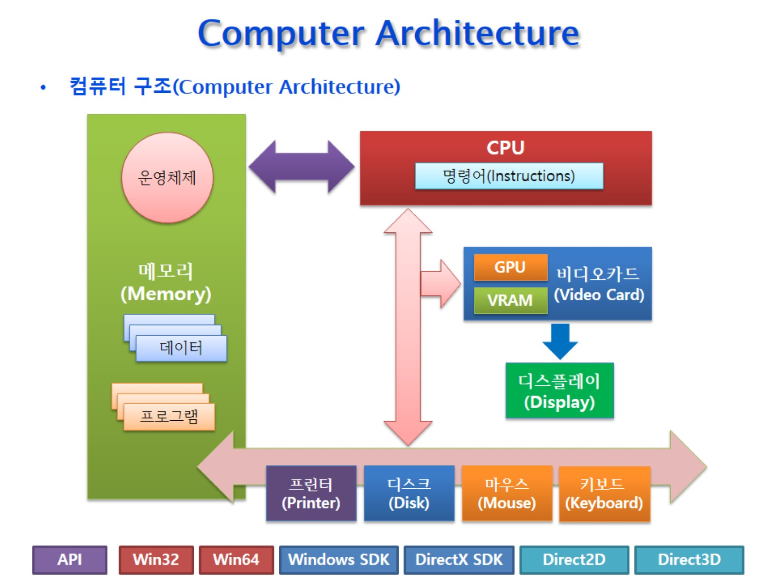
Computer Architecture

Slide 3
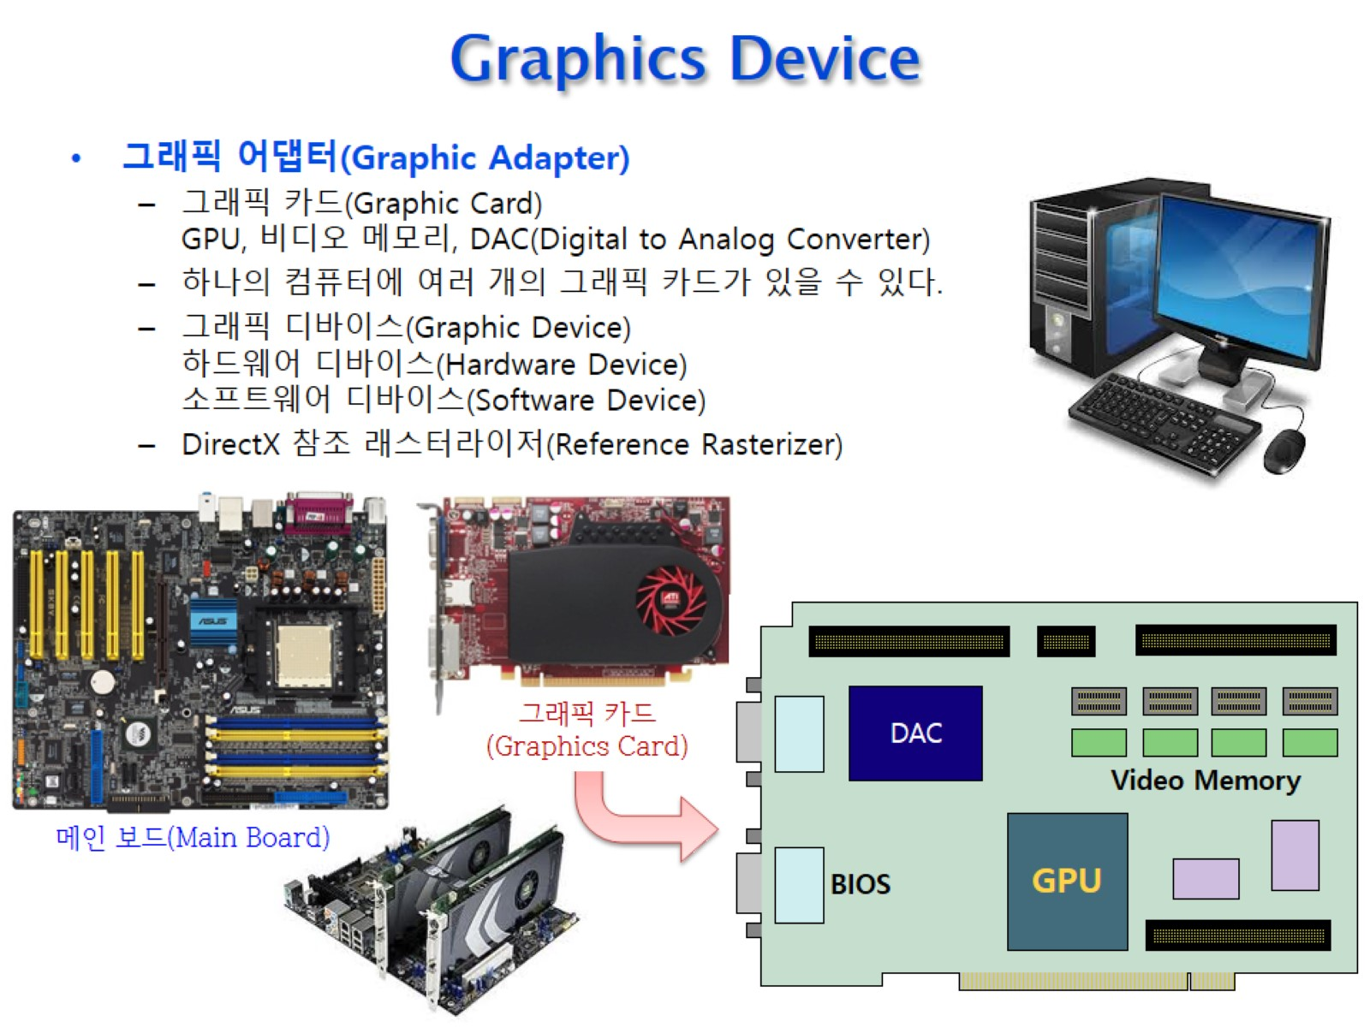
Graphics Device

Slide 4
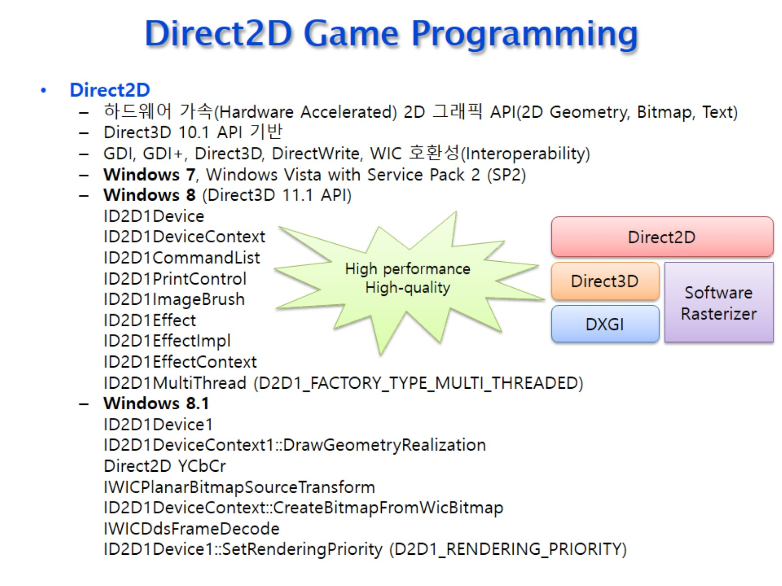
Direct2D Game Programming

Slide 5
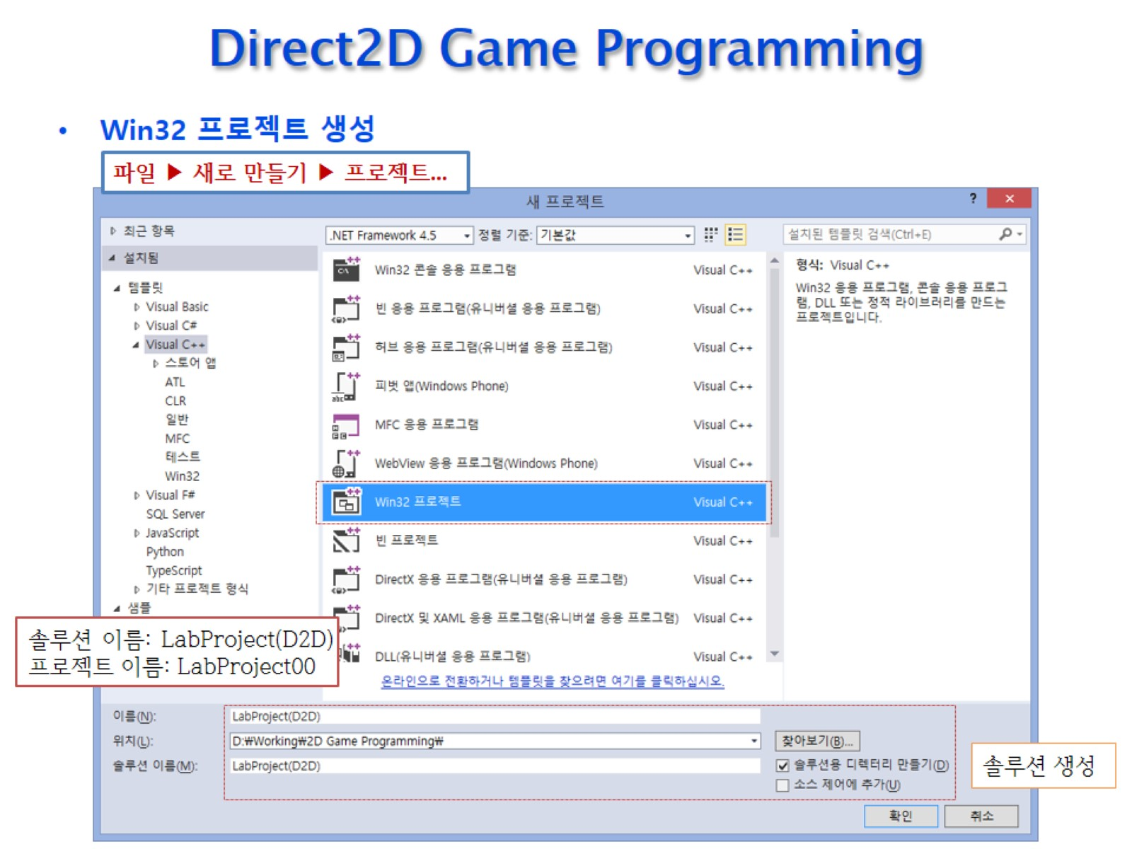
Direct2D Game Programming

Slide 6
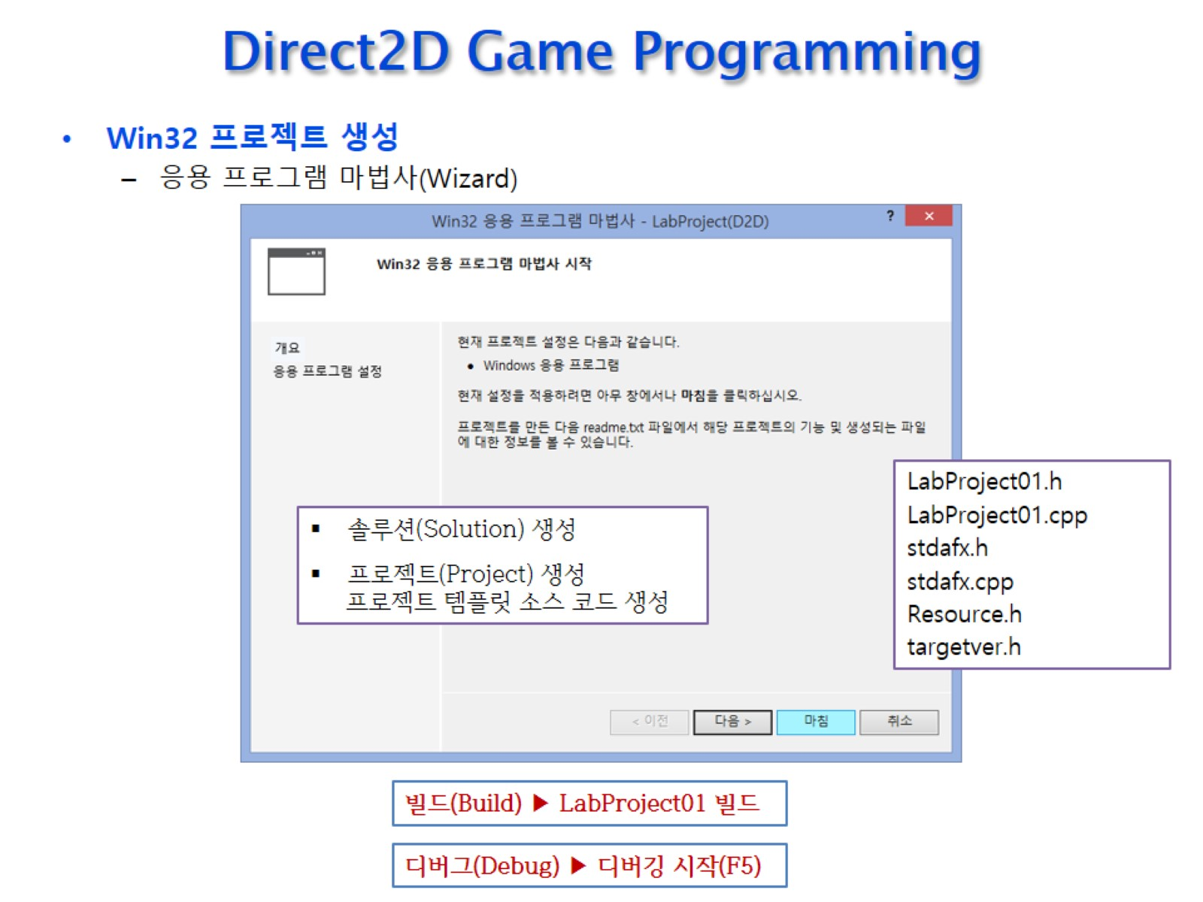
Direct2D Game Programming

Slide 7
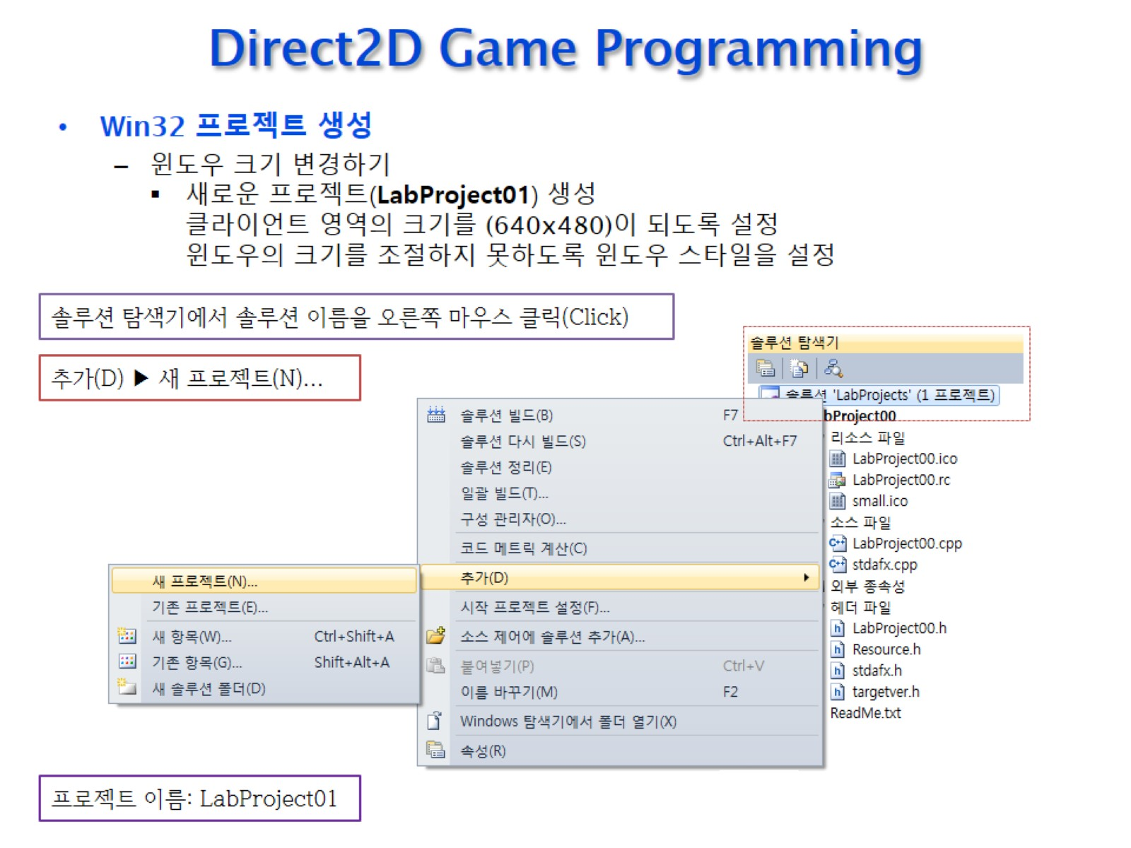
Direct2D Game Programming

Slide 8
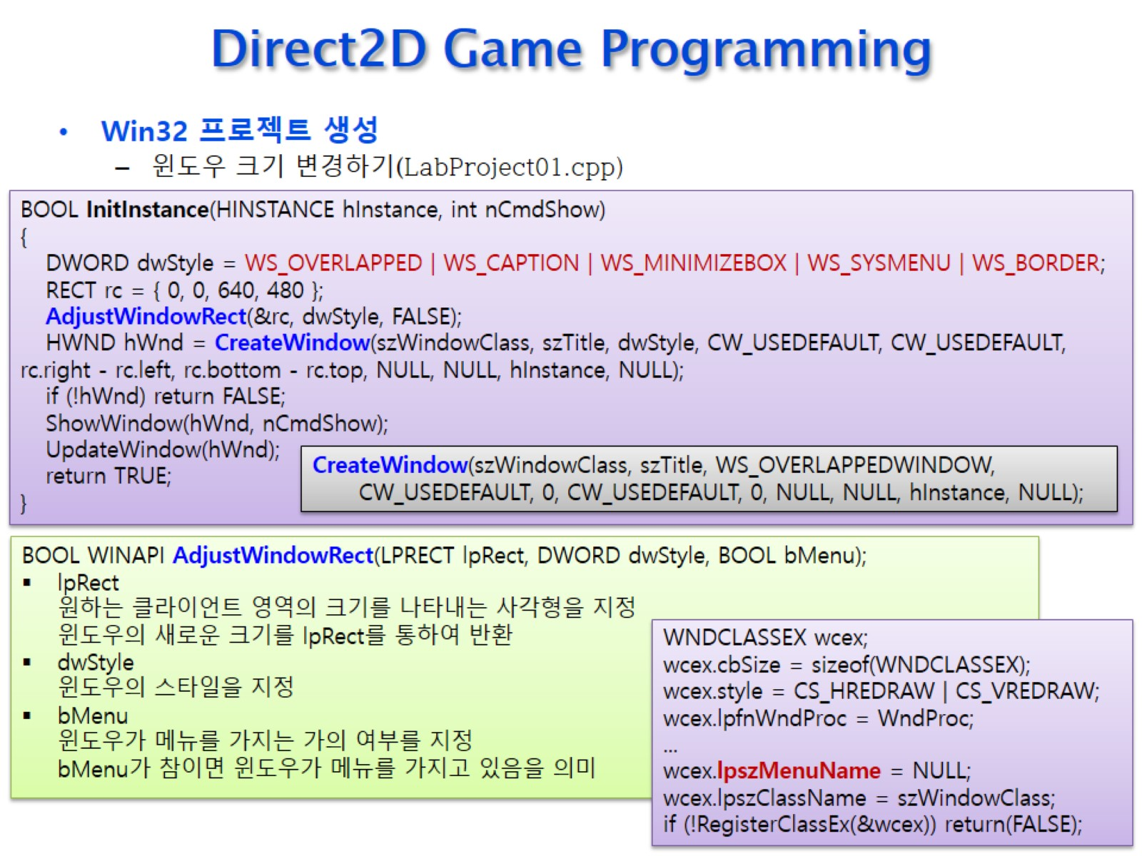
Direct2D Game Programming

Slide 9
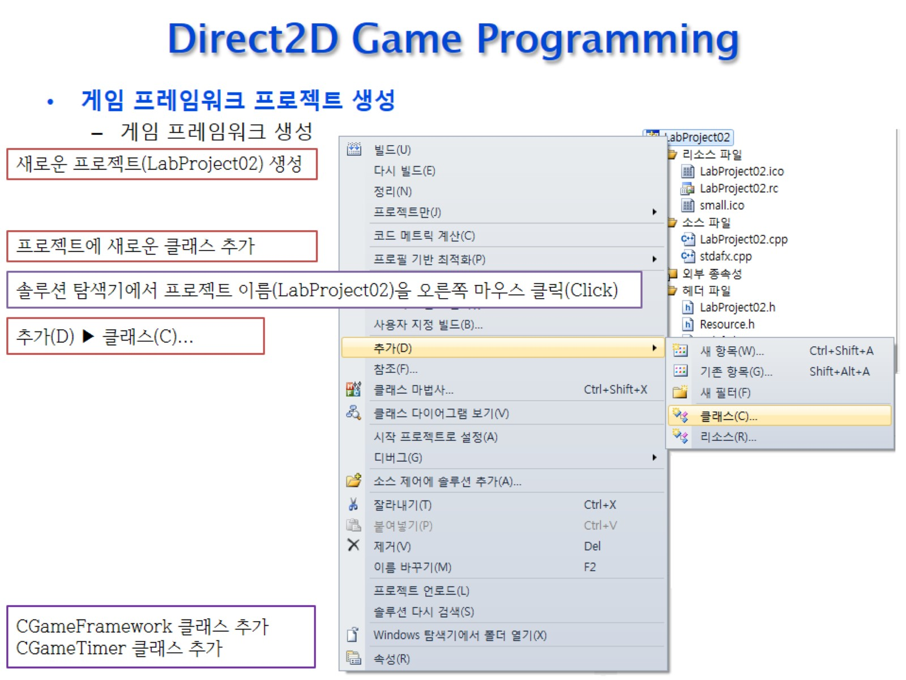
Direct2D Game Programming

Slide 10
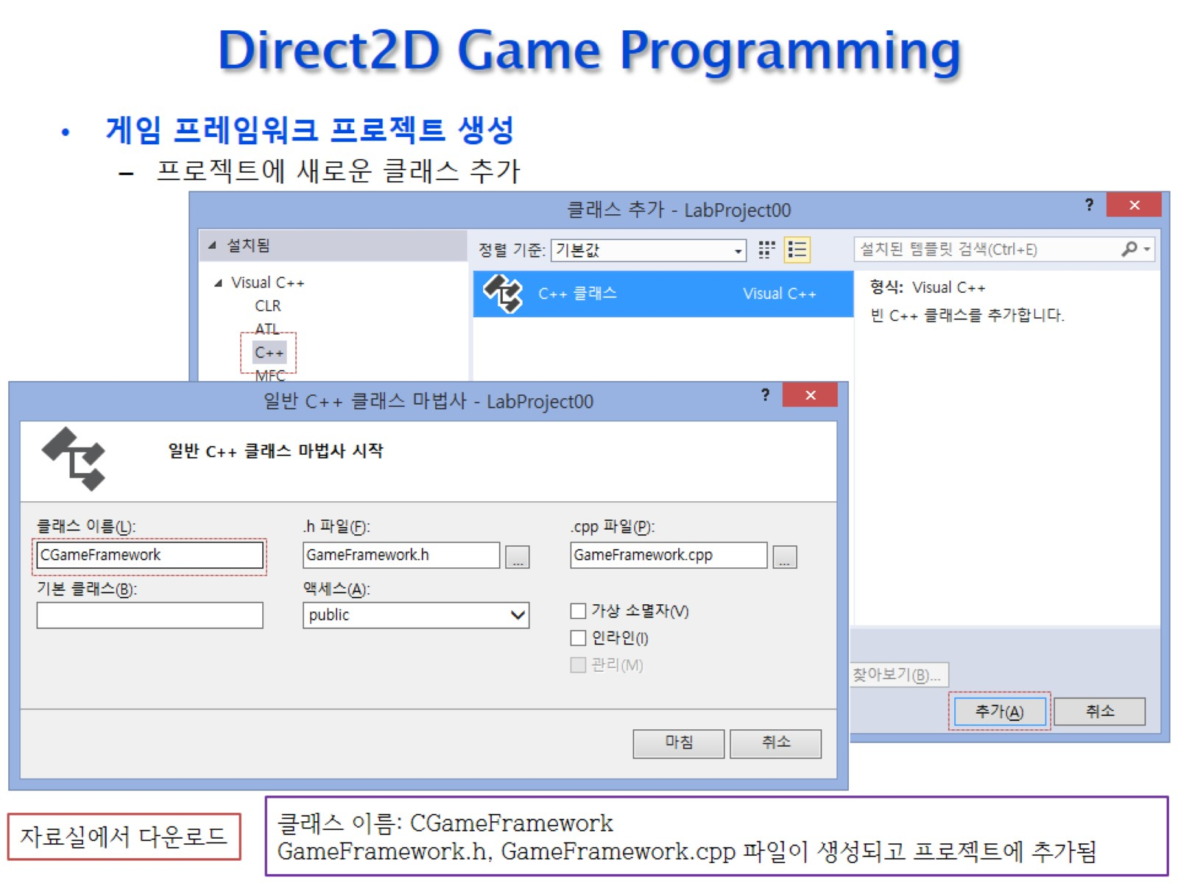
Direct2D Game Programming

Slide 11
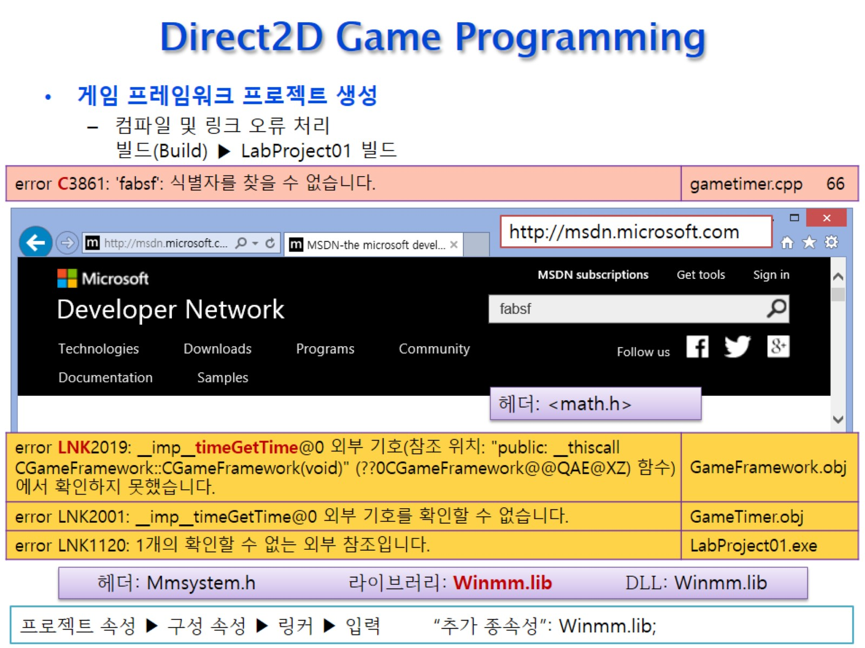
Direct2D Game Programming

Slide 12
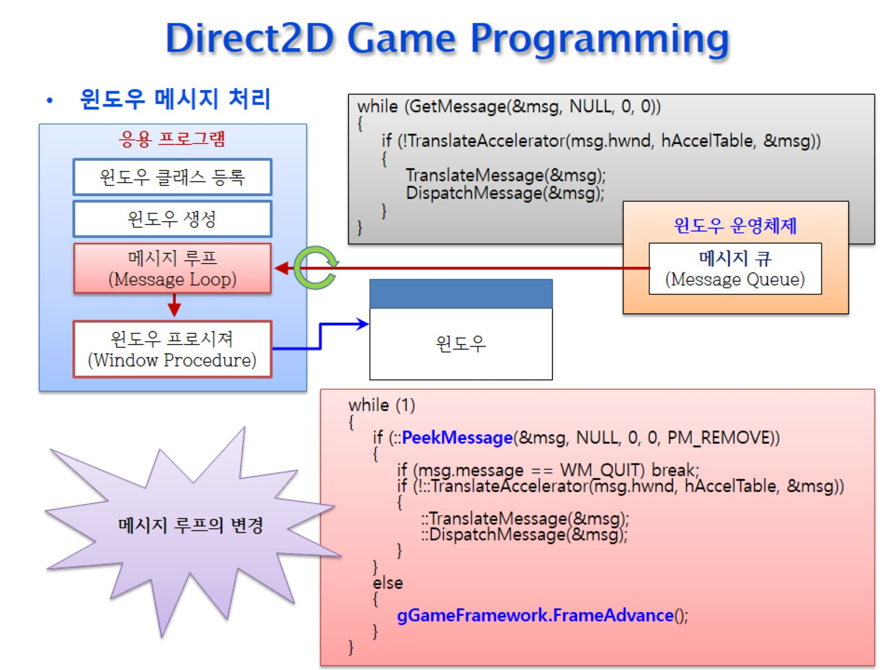
Direct2D Game Programming

Slide 13
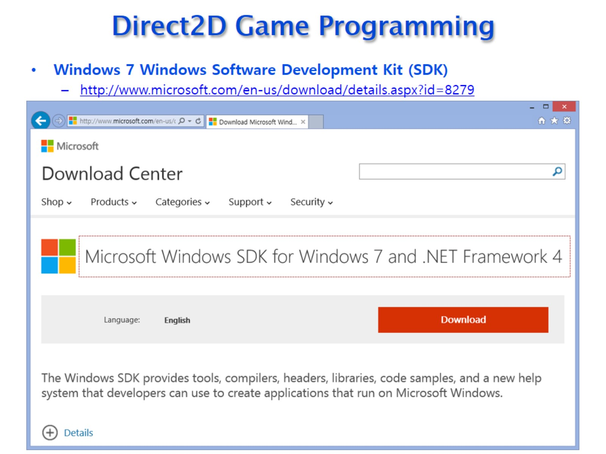
Direct2D Game Programming

Slide 14
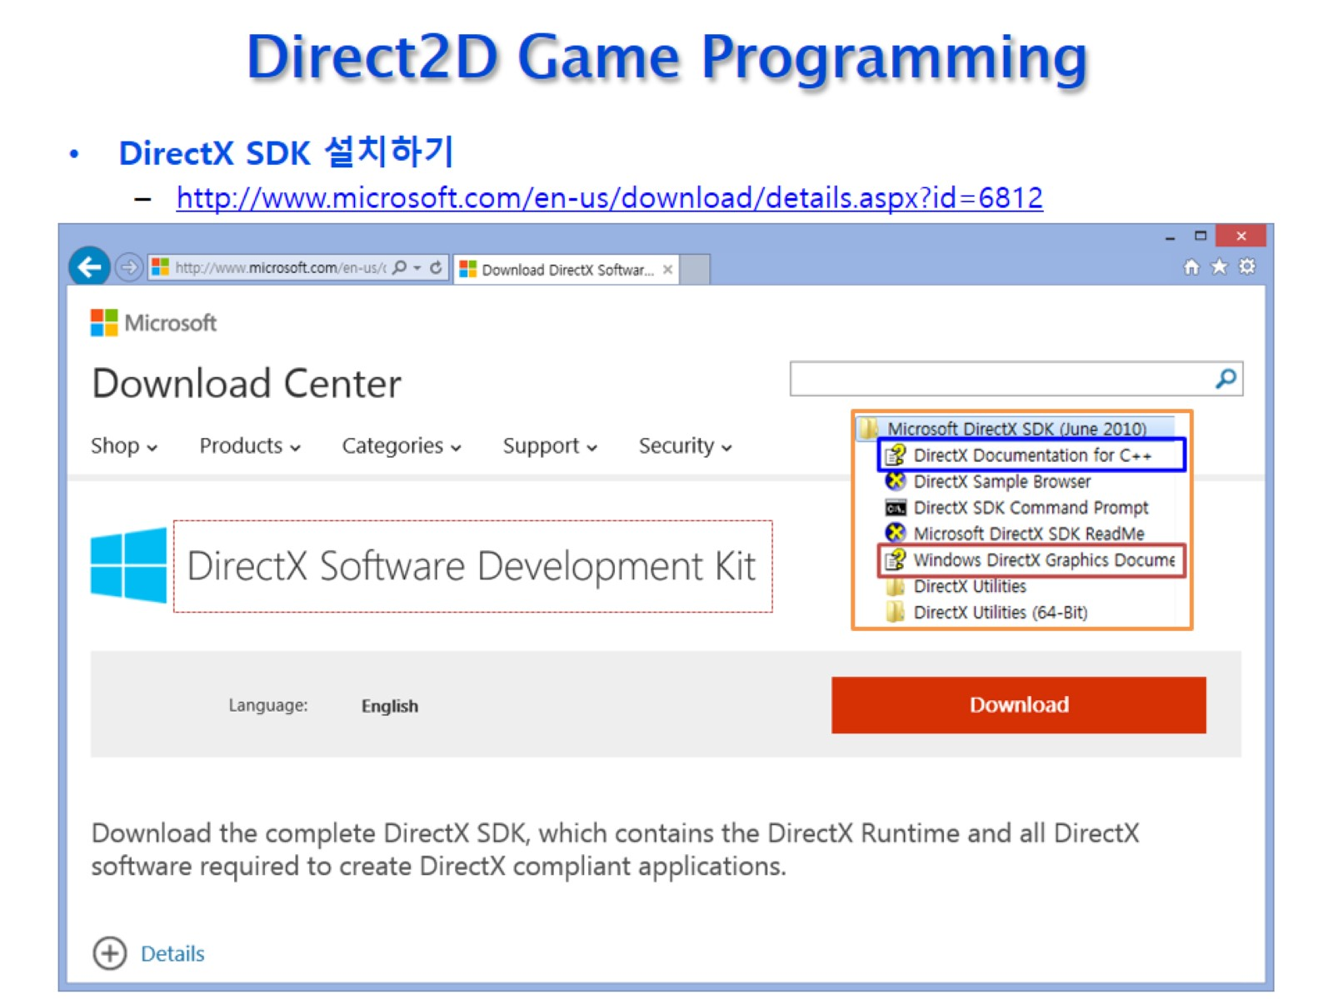
Direct2D Game Programming

Slide 15
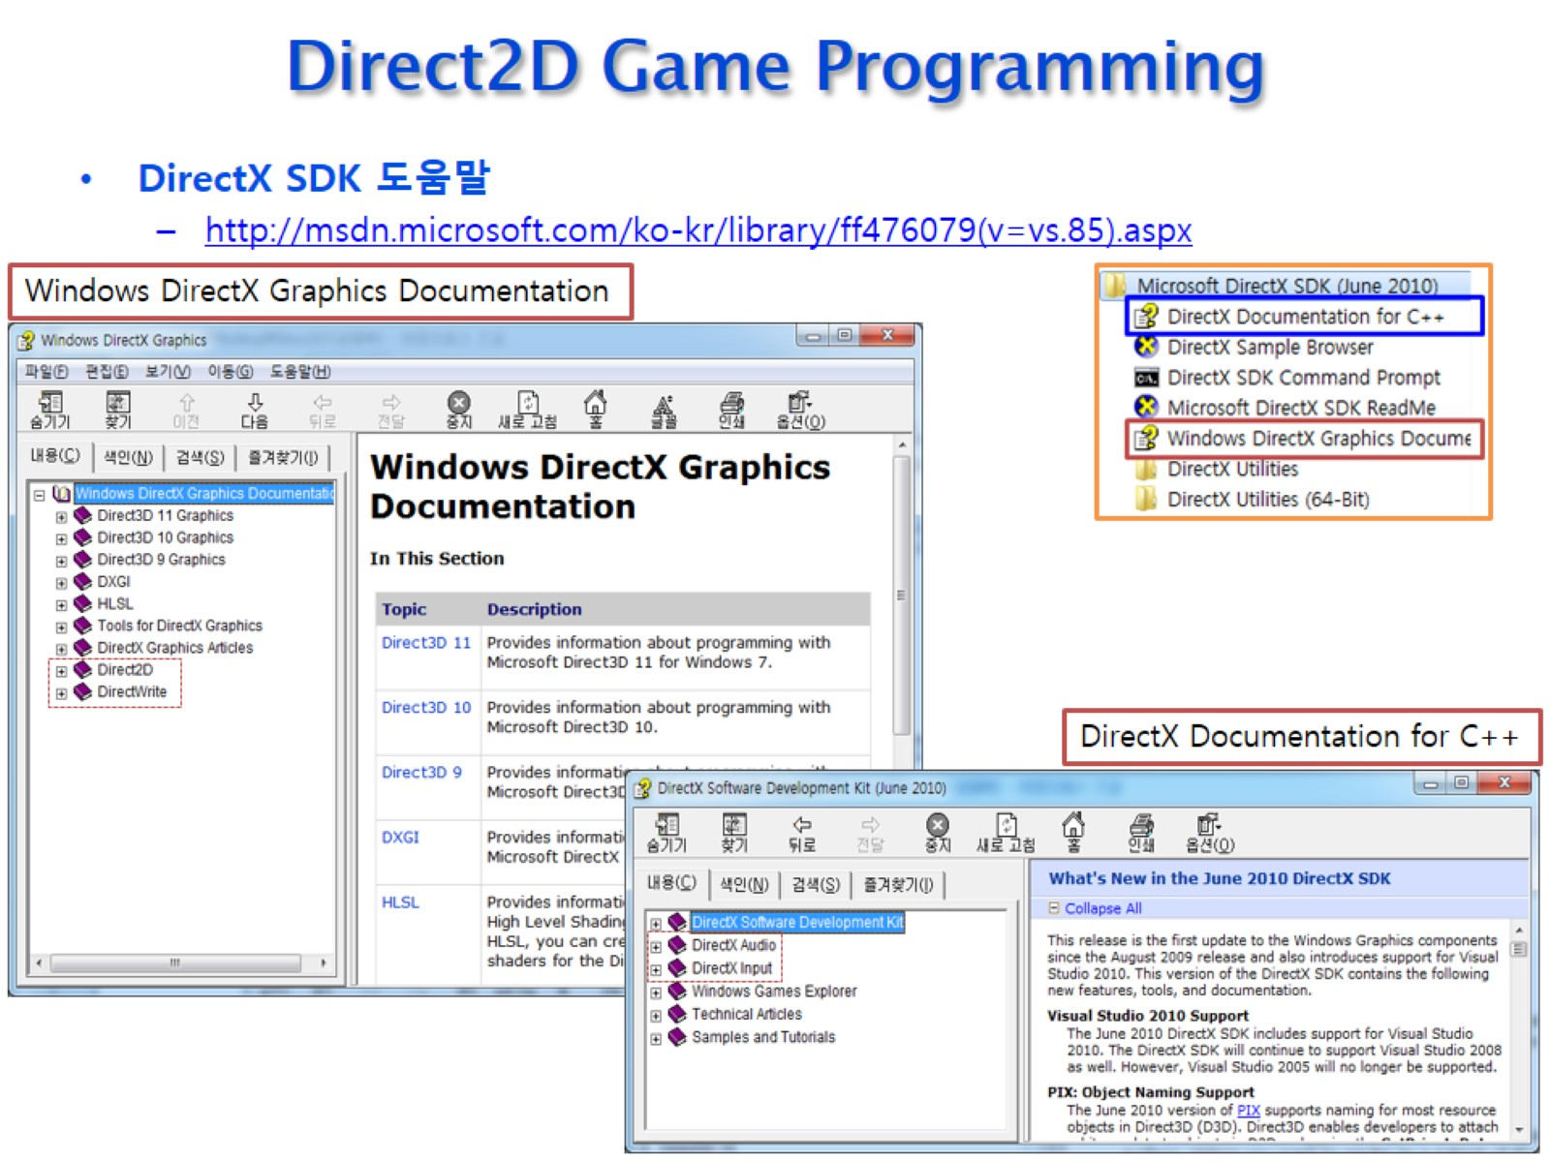
Direct2D Game Programming

Slide 16
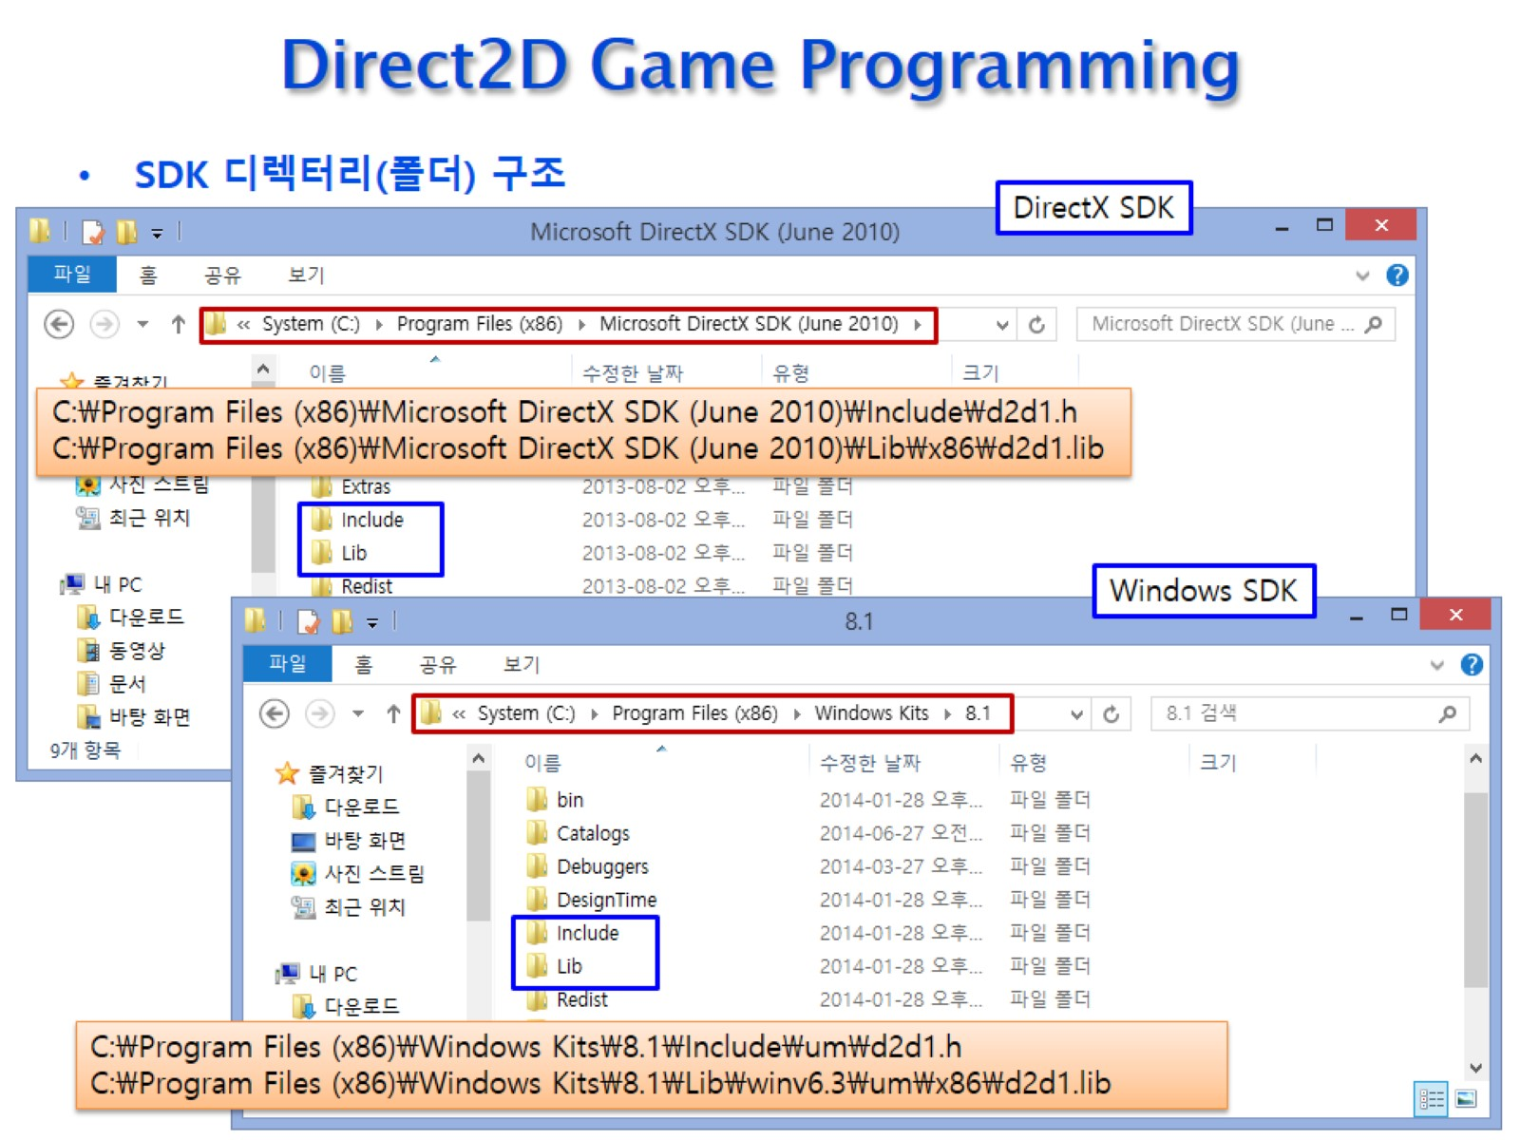
Direct2D Game Programming

Slide 17
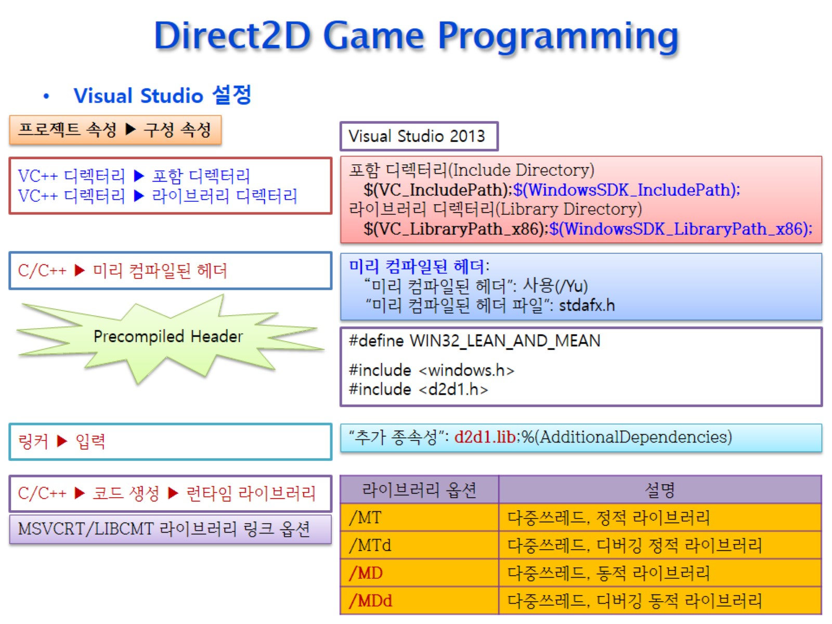
Direct2D Game Programming

Slide 18
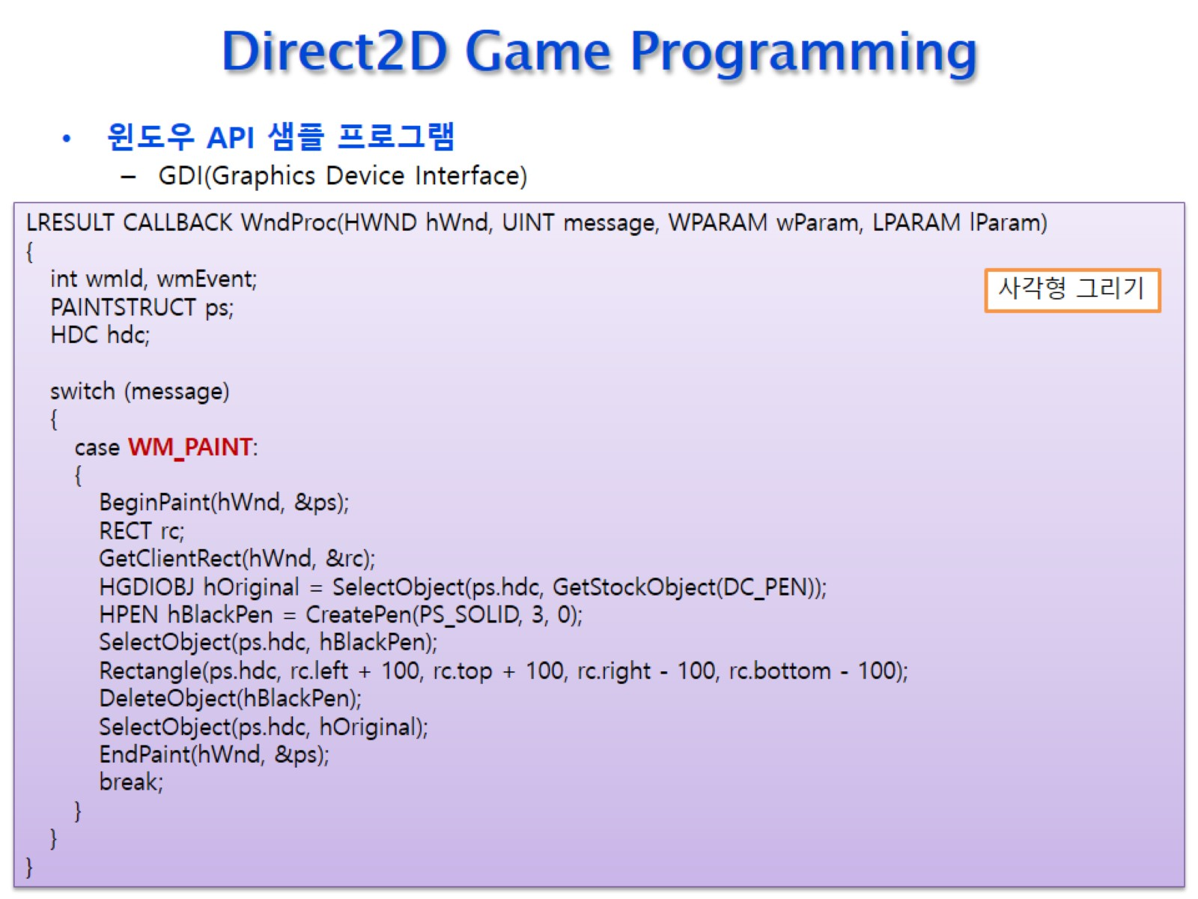
Direct2D Game Programming

Slide 19
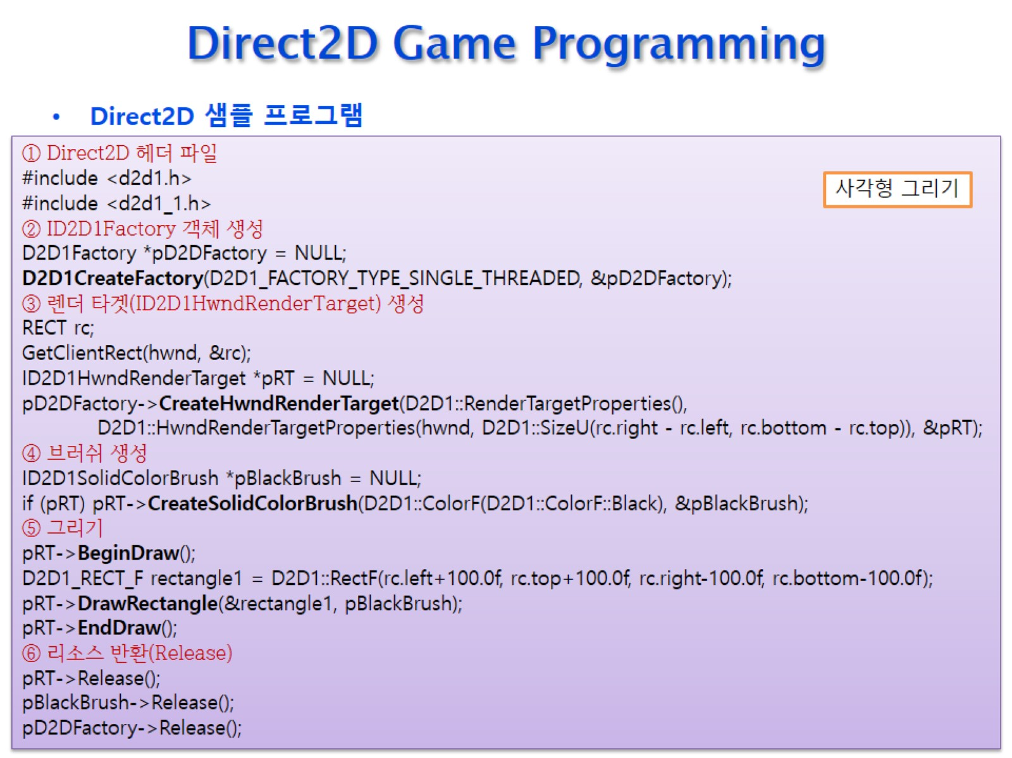
Direct2D Game Programming

Slide 20
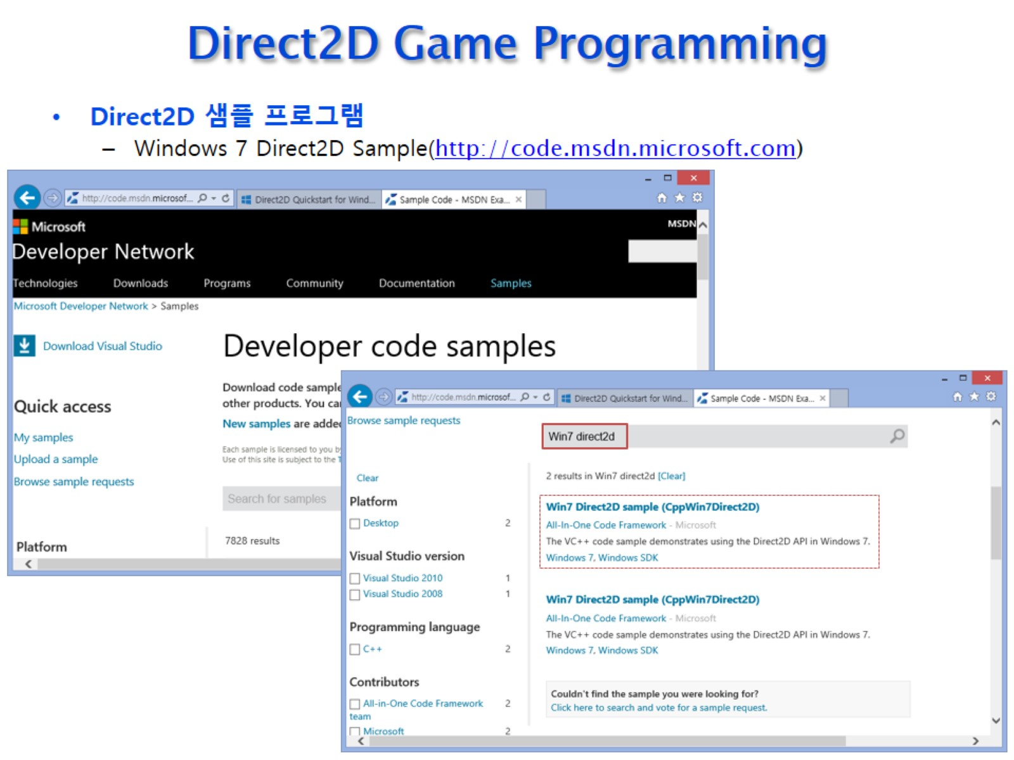
Direct2D Game Programming

Slide 21
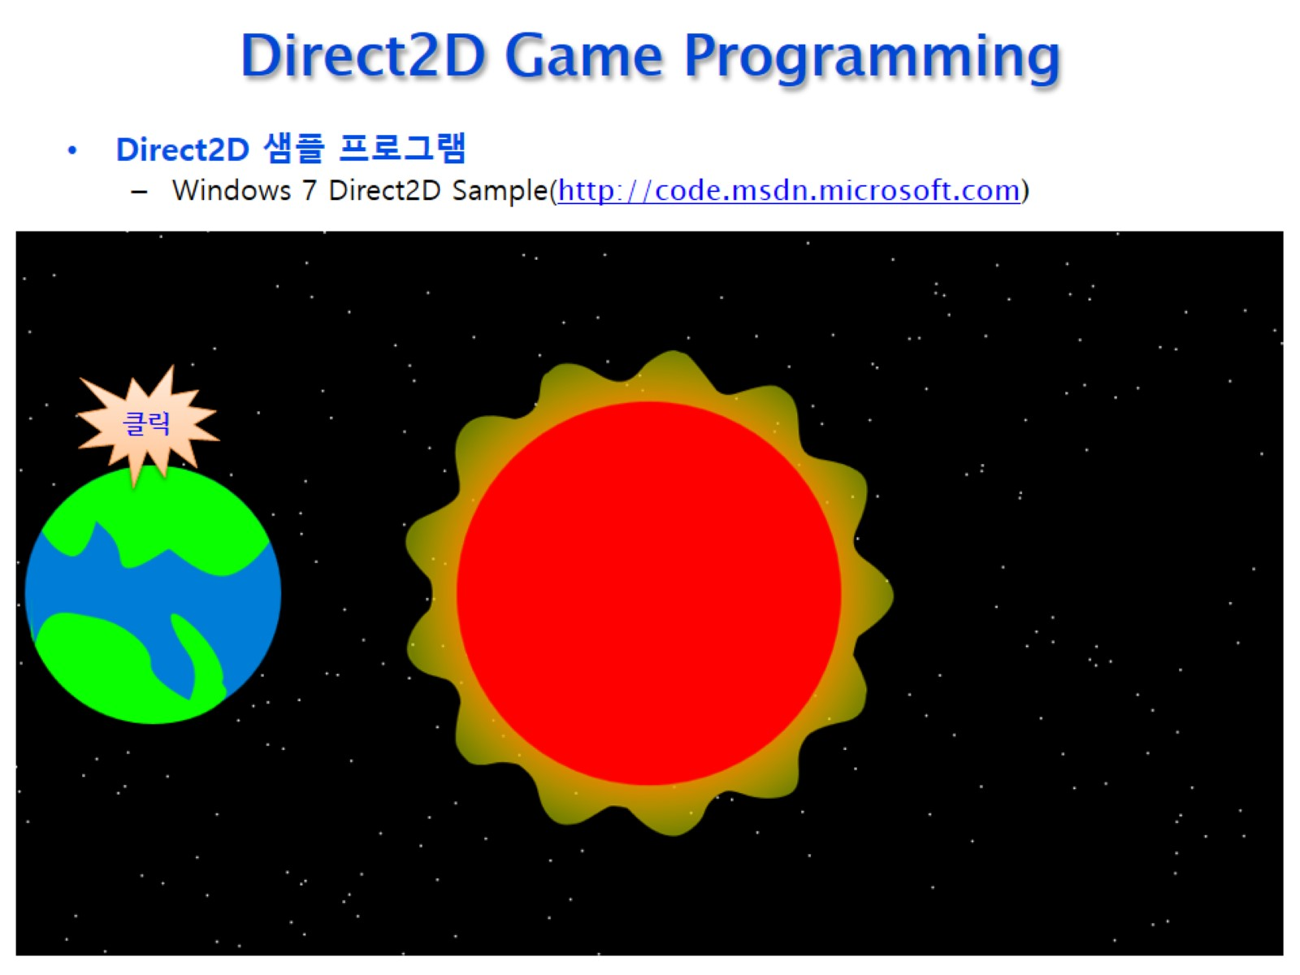
Direct2D Game Programming

